Slide 1
Final Presentation
How various features of East Asian Restaurants in CA
influence their review stars?
Group 5
12/06/2022

Slide 2
Data preprocessing
Extract
1. Extract East Asian Restaurants (Keyword: Chinese, Korean, etc.) in CA
2. Include all original features (e.g. business name, stars and attributes like TakeOut option, Parking availability, etc).
3. Data size: 14825 * 87
Process
1. Remove permanently closed restaurant
2. Extract object data (e.g. hour, parking, etc)
3. Initialize new features (daily & weekly working hour)
Combine
1. Combine business data with review data using ‘business_id’;
2. Apply NLP strategies (e.g. remove stop words, punctuations, symbols; lemmatization)
3.Initialize sentiment (based on customer’s review star)
Polish
1. Unify type in mixed-type feature

Slide 3
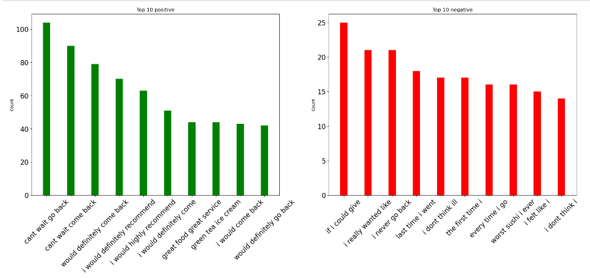
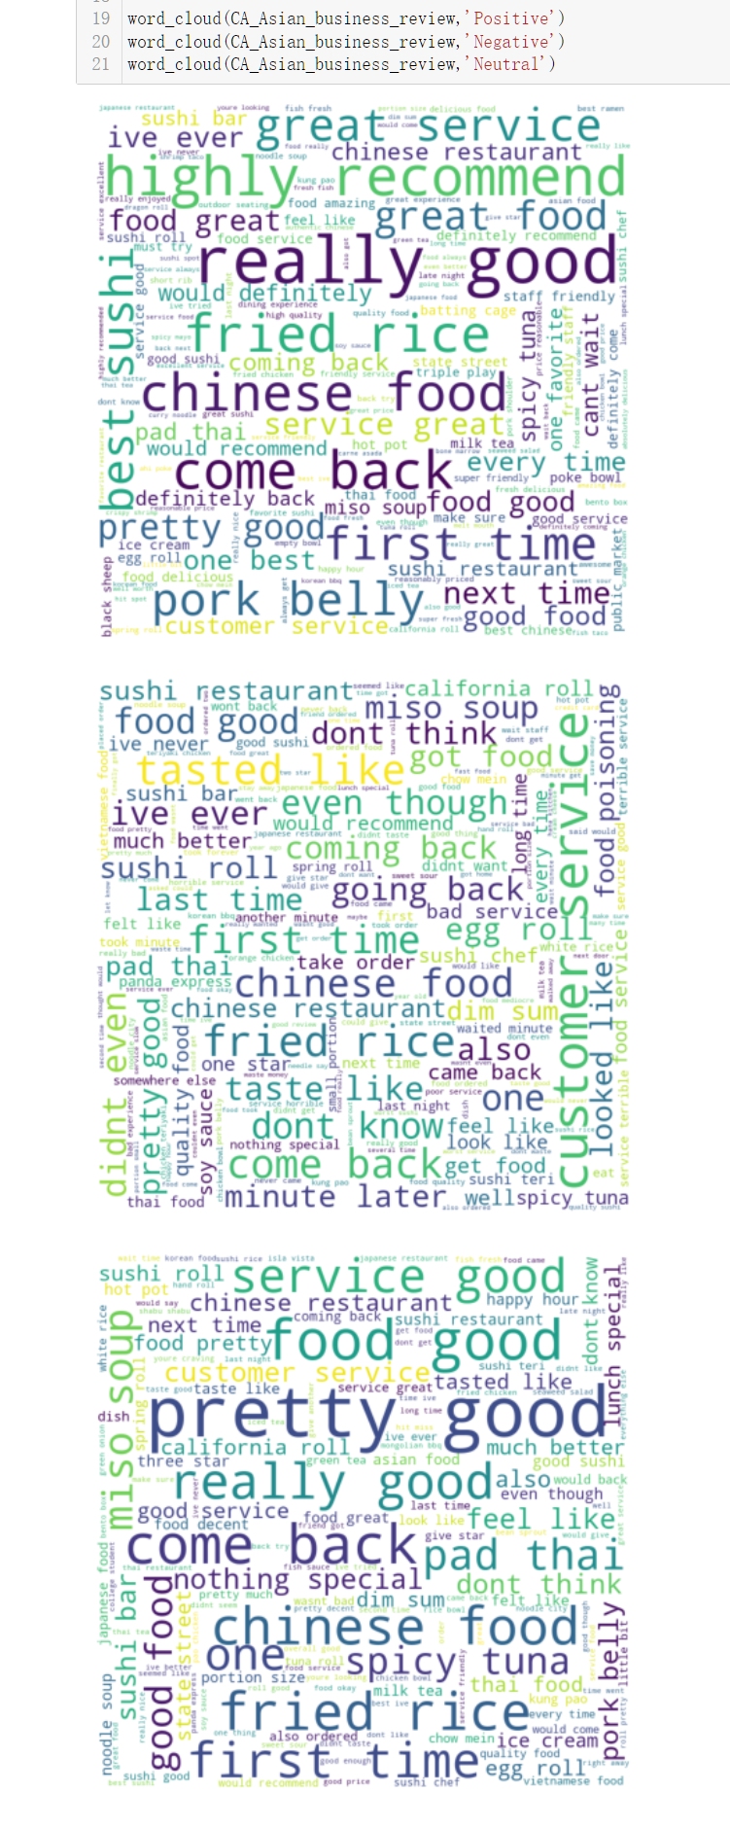
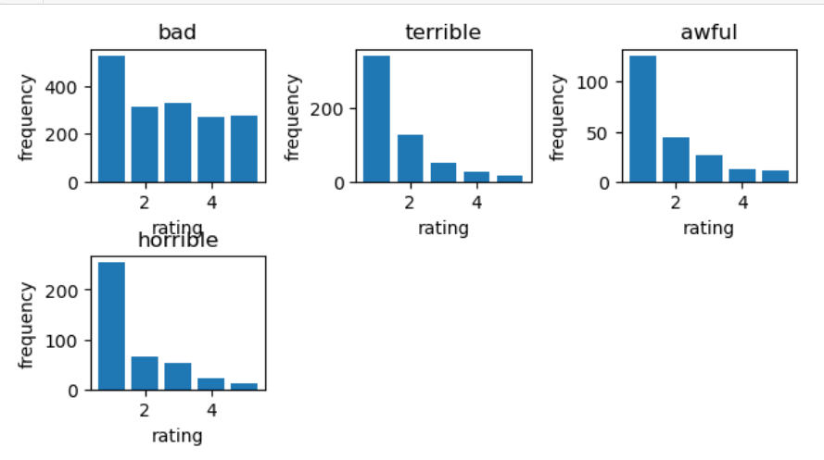
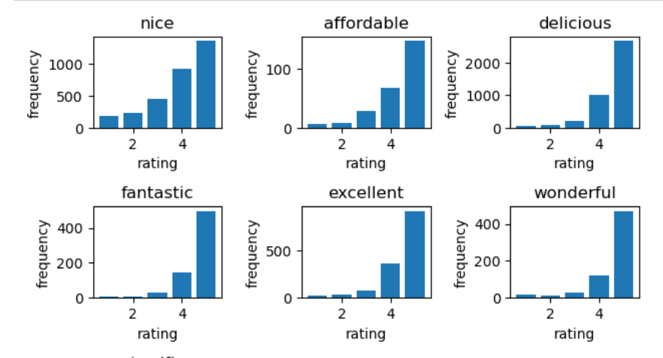
Preliminary Analysis Recap
1. Word cloud
2. N-gram
text
frequency
3. Word sanity check

Slide 4
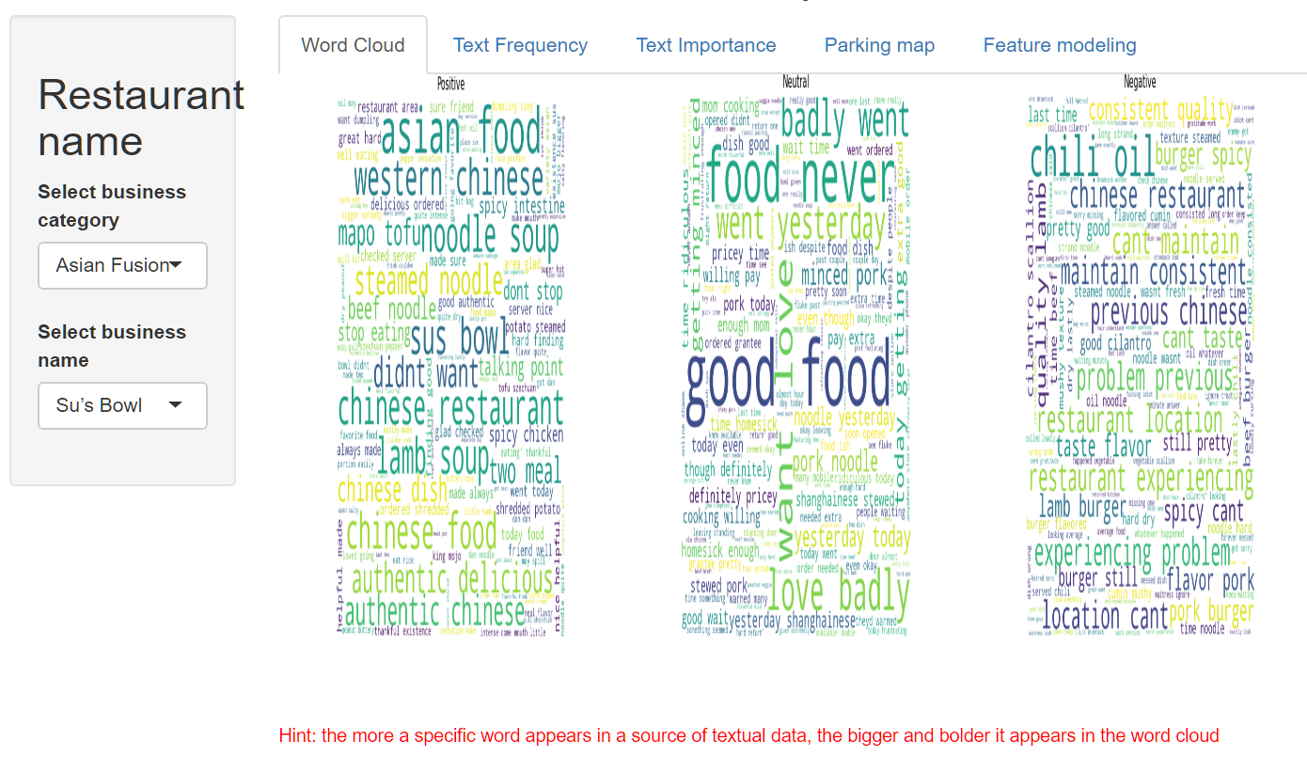
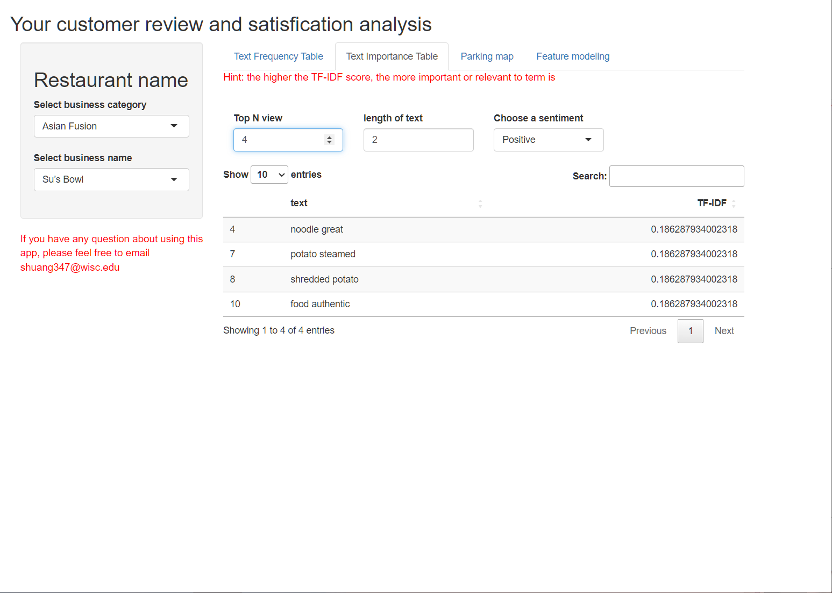
Shiny App: Word Cloud View
Older version
Newer version
Due to python virtual environment on shinyapp.io, python plotting functions can’t be shown properly (word cloud)
Word cloud view was removed in newer version of shiny

Slide 5
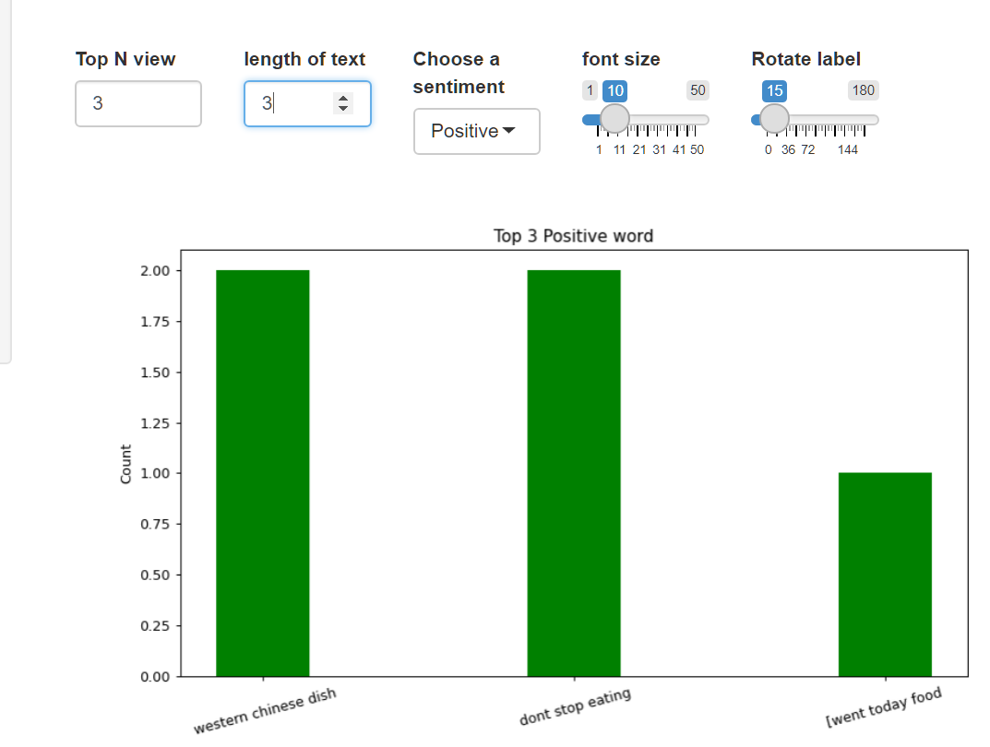
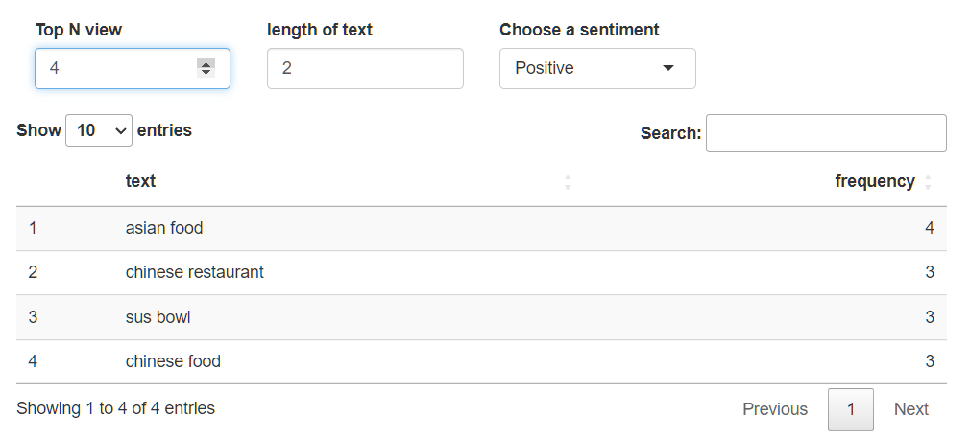
Shiny App: Text Frequency view
Old version
New version

Slide 6
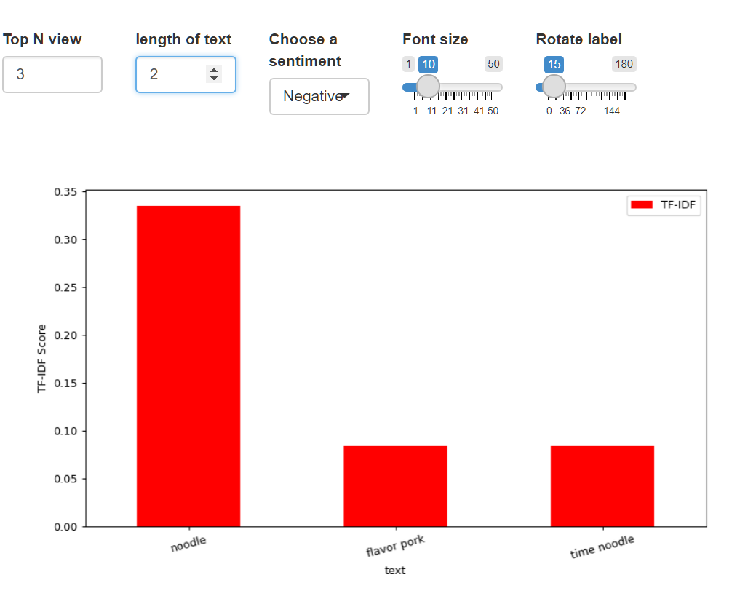
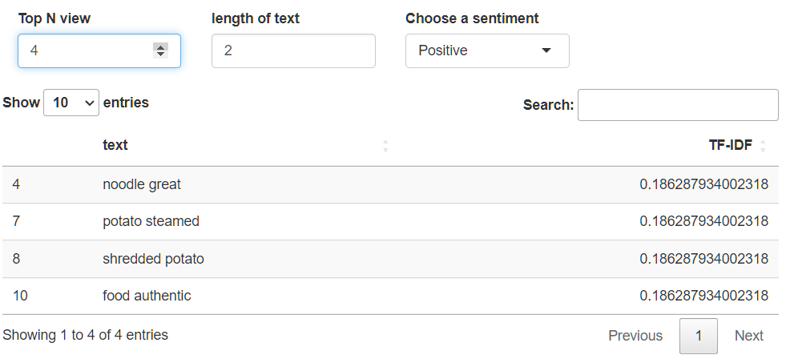
Shiny App: Text Importance View
New version
New version

Slide 7
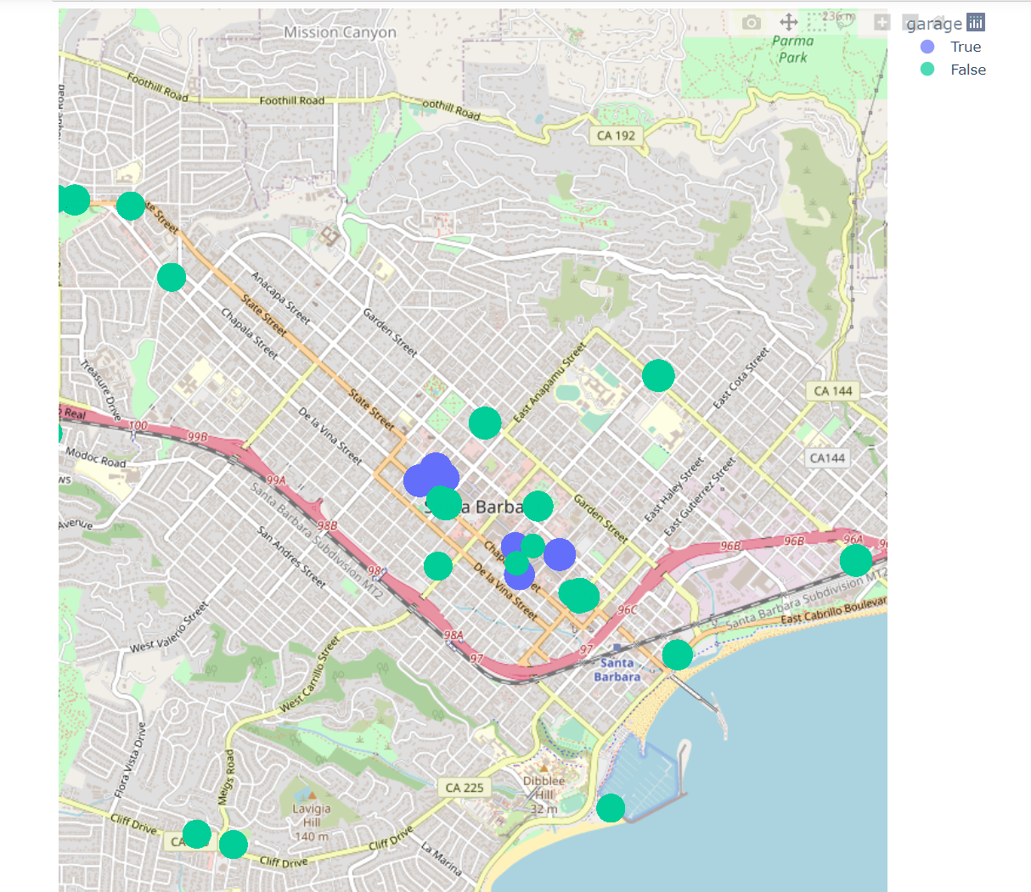
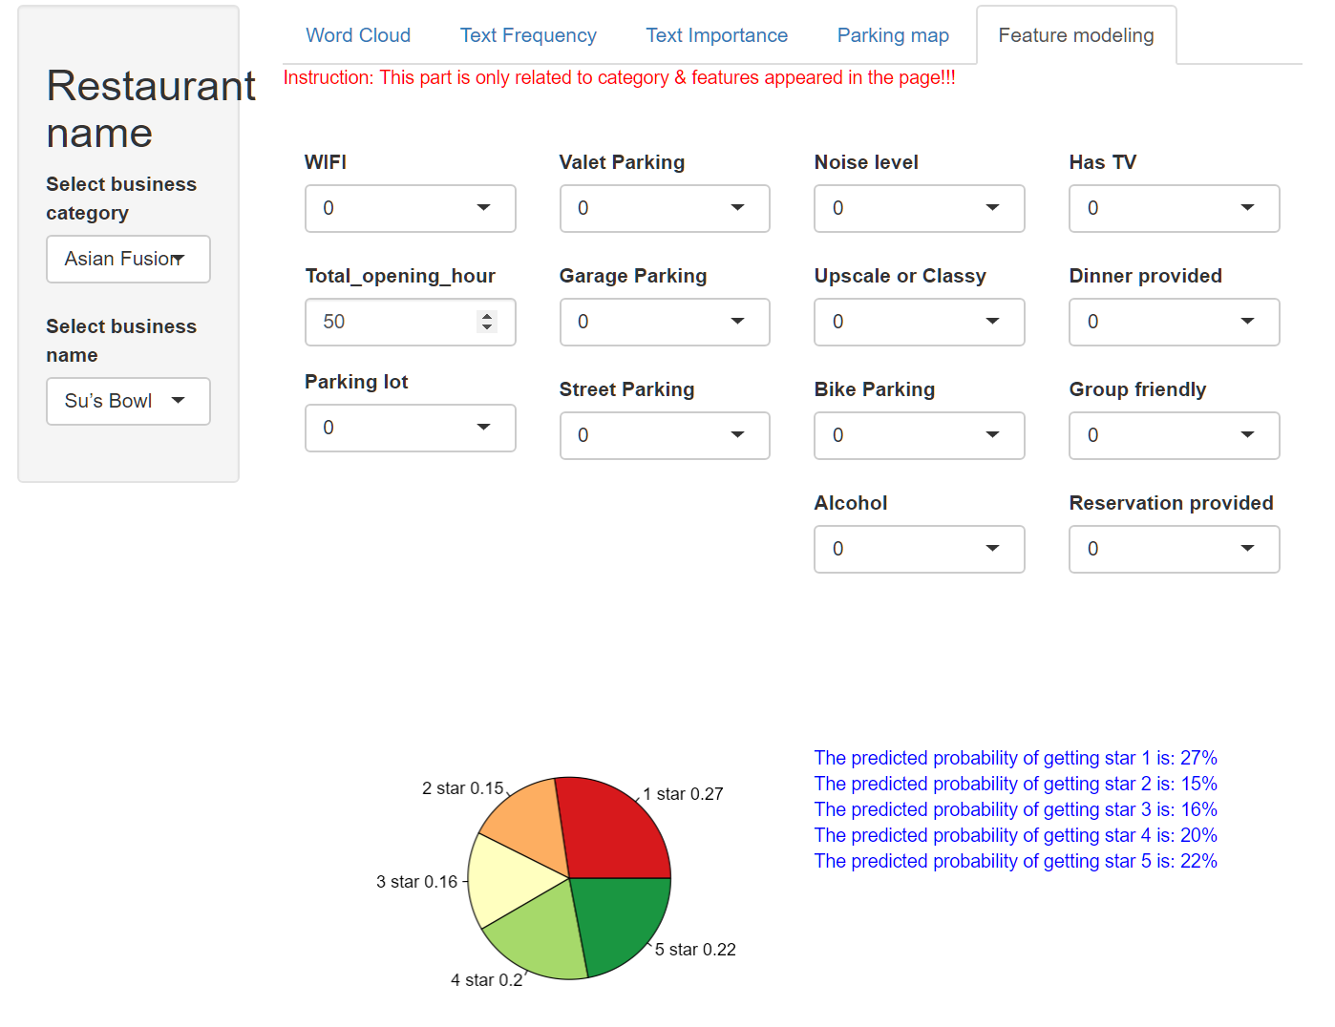
Shiny App: Parking Map & Modeling
Restaurants in downtown Santa Barbara could coporate with nearby parking log/garage to attract customers who own vehicles.

Slide 8
Modeling data
Y
X
comment star | Hour per week | HasTV | Alcohol | WiFi | Garage | Dinner | Accept Noise
Star given by customer | Weekly open hours of each restaurant | Is there a TV in the restaurant | Provide Alcohol or not | Is free WiFi available | Any place to park cars | Provide dinner Or not | Is the noise acceptable
Multi- Categorical Ordinal (1,2,3,4,5) | Continuous (16h-102h) | Binary Categorical data (1 indicates yes; 0 indicates no)

Slide 9
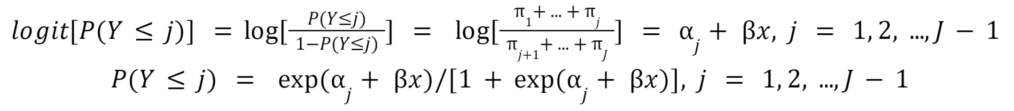
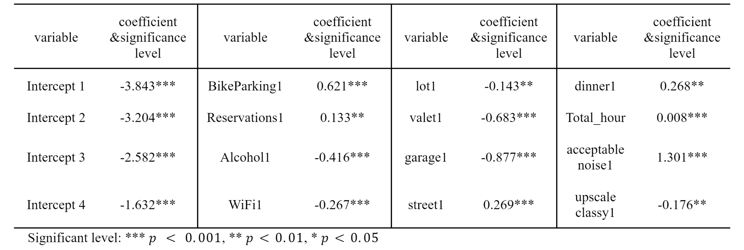
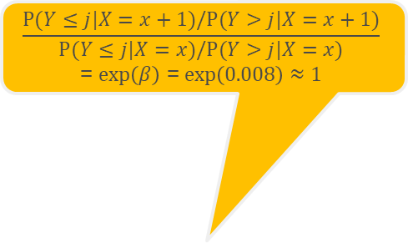
Cumulative Logit Models For Ordinal Responses
Model function:
Result with 12 significant features:
$$\frac{P(Y≤j|X=x+1)/P(Y>j|X=x+1)}{P(Y≤j|X=x)/P(Y>j|X=x)}$$
= $\exp\left(β\right)$ = $\exp\left(0.008\right)≈1$

Slide 10
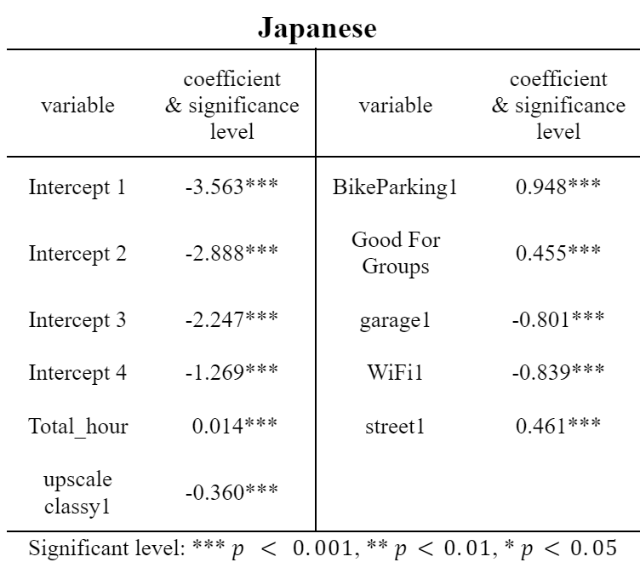
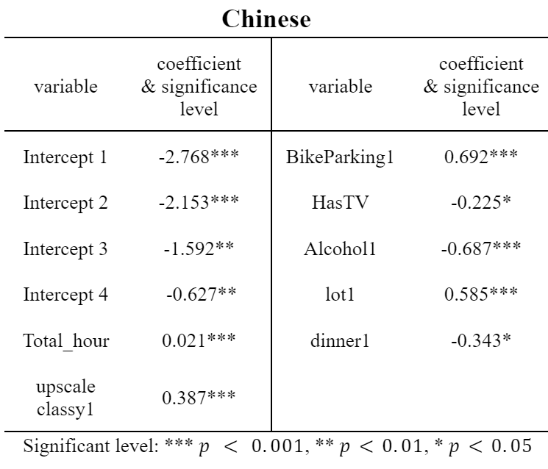
Cumulative Logit Models under different categories
Difference between Japanese and Chinese restaurants:

Slide 11
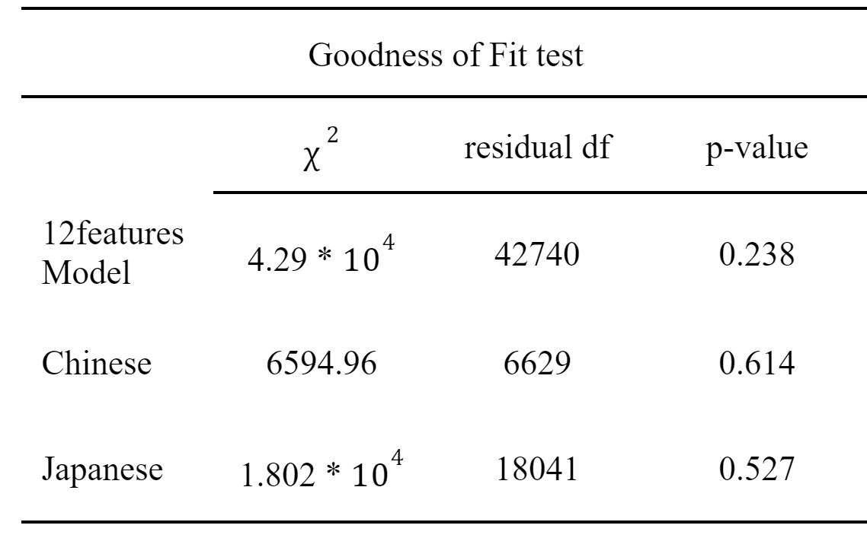
Goodness of fit test
H0: The model fits the data well
H1: The model doesn’t fit the data well

Slide 12
Conclusion
Provide more attentive service to make customers give more positive reviews
Working longer will not improve ratings
Different categories of restaurants need to focus on different features to make improvements

Slide 13
Limitation
Improve model prediction accuracy
Further explore features that are highly correlated with rating stars
Provide customized suggestion for each business
Apply vertical research on how specific restaurant can be improved based on customers review

Slide 14
THANK YOU

